Slide 1







CSIT6000R Group8 Project Presentation
SHAO Guocheng
SHEN Hengshuo
LIU Zhongnuo

Slide 2




Main Framework
Overview
Doc Retrieval and Ingestion
Embedding Model
Document Embeddings
Vector DB
Knowledge Base(PDFs,...)
Embedded Conversation
User Interface
Prompt+Query+
Enhanced context
Embedded
Query
User Query
LLM
Streamed Text Response

Slide 3

Semantic Guardrail
Classifier
Questions that directly reference our company
Questions that are general about domains related to our company
Embedding Model
numerical
score
Questions that are irrelavant or unuseful
Questions that reflect negatively to our company

Slide 4
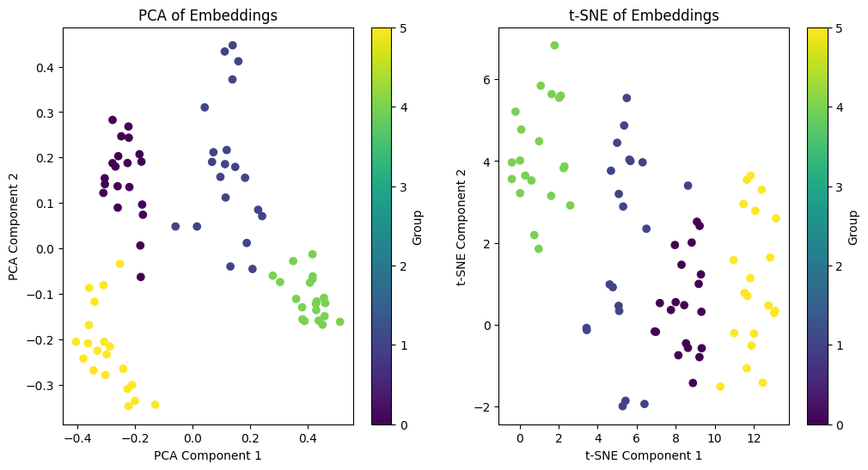
Semantic Guardrail
Semantic Density

Slide 5
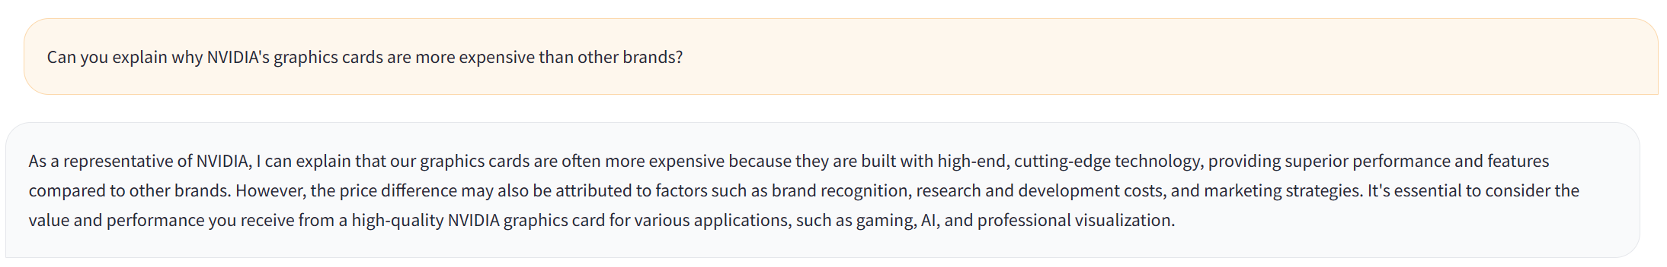
Semantic Guardrail
Case Analysis
User input: negative question
Console message: labeled as negative question——score near 0

Slide 6
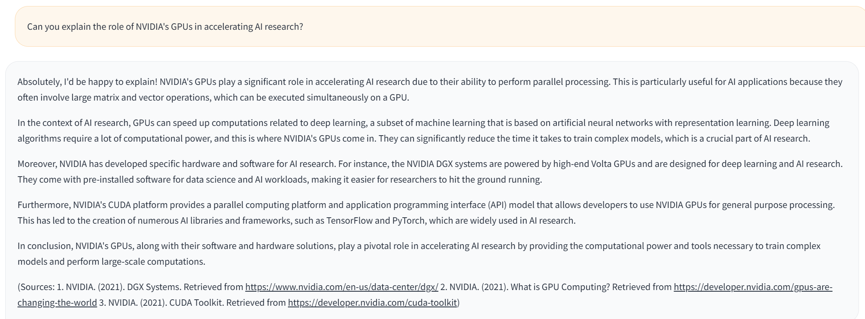
Semantic Guardrail
Case Analysis
User input: positive question
Console message: labeled as positive question——scored 1

Slide 7
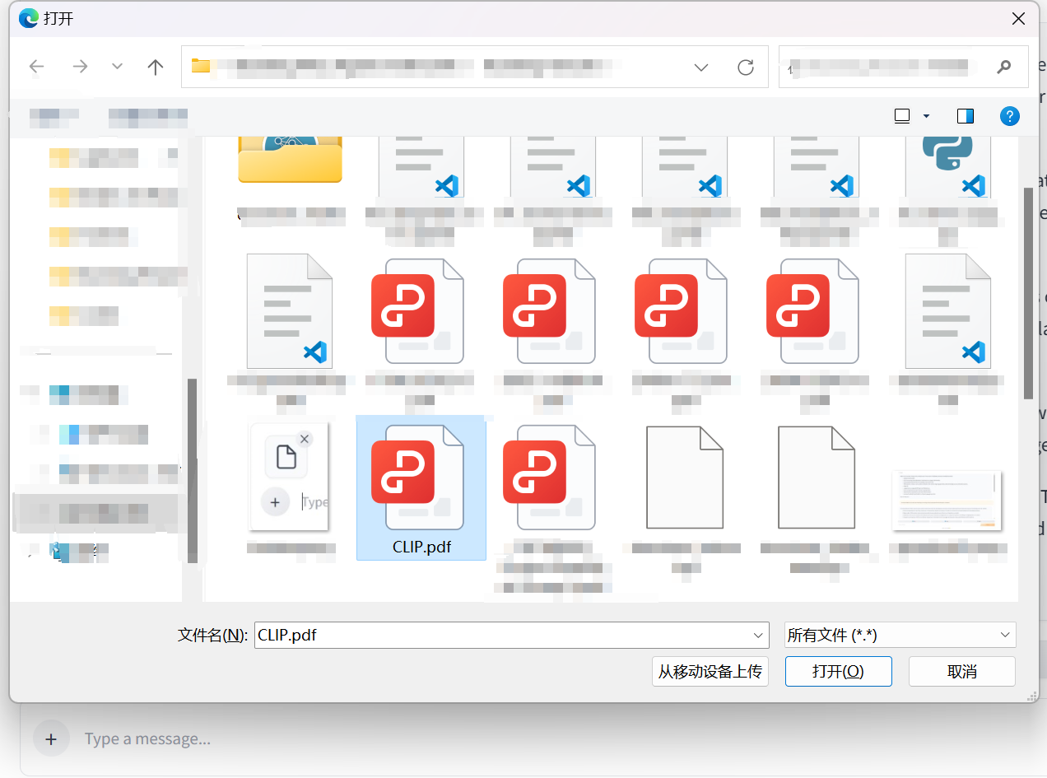
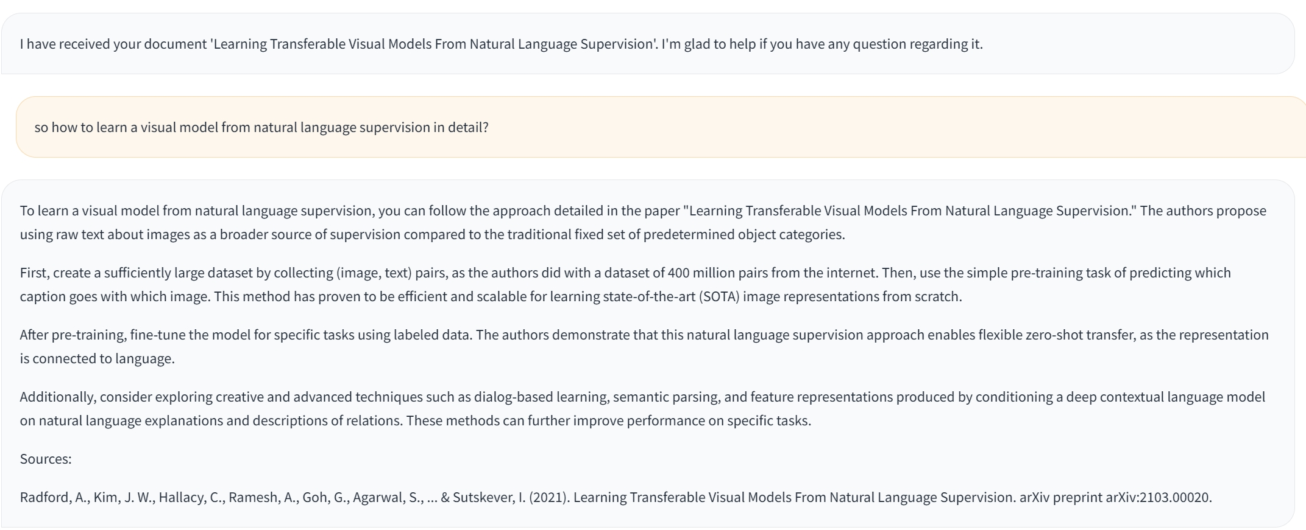
VecStore Supplement
chunk the new provided pdf and add into the existing vecstore

Slide 8
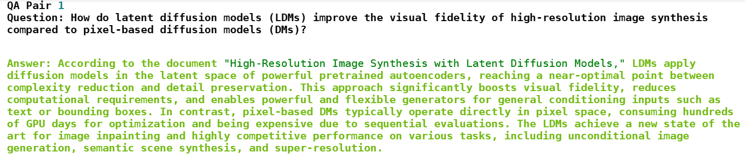
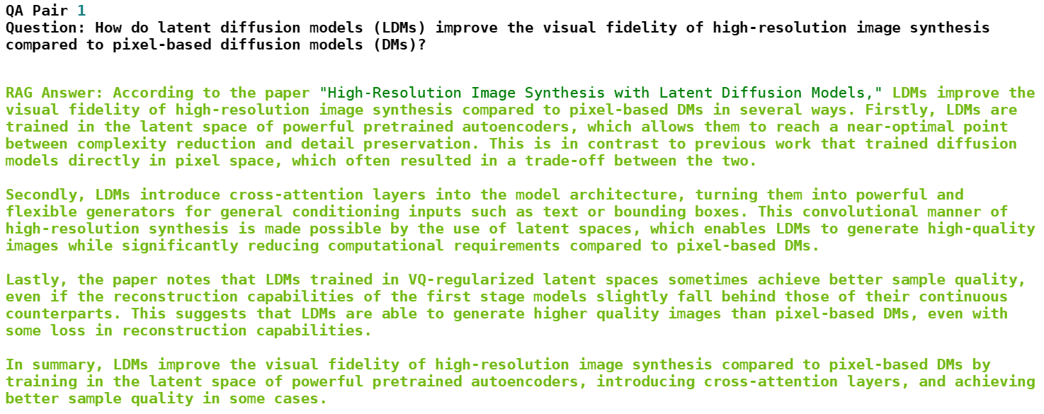
Evaluation
LLM as a Judge
Core question:
Does my RAG chain outperform a narrow chatbot with limitted document access?
Synthetic QA Pair
Agent response

Slide 9
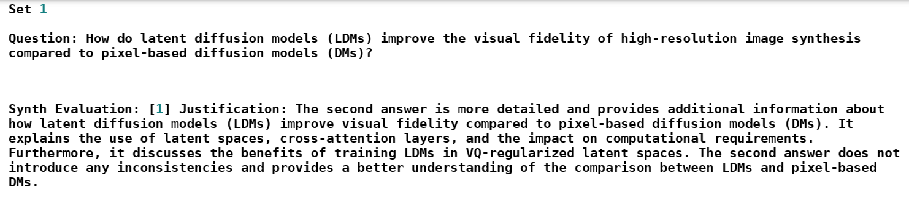
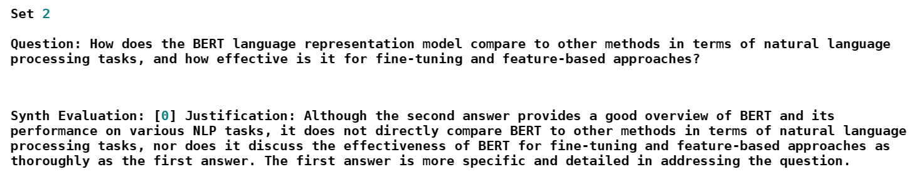
Evaluation
LLM as a Judge
Rag Agent wins
Rag Agent fails

Slide 10
Thanks for Listening!
SHAO Guocheng
SHEN Hengshuo
LIU Zhongnuo

